Slide 1

Analysis of Healthcare Quality in Pakistan
Unveiling Insights from Social Media Data
Group Members
Sadia Noor
Aaqib Ali
Javeria Ahmed

Slide 2
Content
Motivation
Aims and Objectives
Related Work
Methodology
Results
Conclusion
References

Slide 3

Motivation
Analyzing healthcare quality in Pakistan using social media data.
approach to gaining insights into public sentiment.
perceptions regarding healthcare services.
Alignment with Sustainable Development Goals (SDGs)
SDG 3: Ensure healthy lives and promote well-being for all.

Slide 4
Aims and Objectives
Aims
To analyze and understand healthcare quality in Pakistan through the lens of social media data, focusing on public sentiment and perceptions.
Objectives
Utilize social media data to gather insights into healthcare discussions and public opinions.
Address challenges and opportunities within Pakistan's healthcare system based on sentiment analysis.
Explore and interpret public sentiment towards healthcare quality, identifying patterns and trends from social media discourse.

Slide 5
Related Work 1/3
Title: Healthcare in Pakistan: Navigating Challenges and Building a Brighter Future by Muhammad, Q. et al. (2023)
Data: Review article focusing on healthcare challenges and improvements in Pakistan.
Methodology: Descriptive review discussing healthcare infrastructure, financial support, public-private partnerships, and healthcare programs in Pakistan.
Results: Pakistan's healthcare system faces challenges like a shortage of hospitals, doctors, and medicines, and a lack of trust. Public-private partnerships (PPPs) and programs like National TB Control and LHW Program aim to improve healthcare. Advocacy for adequate financial support and infrastructure development to enhance healthcare delivery in Pakistan.

Slide 6
Related Work 2/3
Title: Perceptions of healthcare professionals and patients on the role of the pharmacist in TB management in Pakistan: A qualitative study by Atif, M. et al. (2022)
Data: Data from semi-structured interviews at the Chest Disease Unit of Bahawal Victoria Hospital, Punjab, Pakistan.
Methodology: Large-scale qualitative study using semi-structured interviews and thematic analysis.
Results: Identified 19 categories and 7 themes. Physicians see pharmacists as professionals; patients see them as dispensers. Key roles include inventory management, dispensing, and counseling.
Barriers: regulatory interest, training, competency. Need for integrating pharmacists due to overburdened physicians, patient care issues, and medication safety.

Slide 7
Related Work 3/3
Title: Pharmacists' viewpoint towards their professional role in the healthcare system: a survey of hospital settings of Pakistan by Khan, N. et al. (2020)
Data: Survey of pharmacists in 26 tertiary care hospitals across Pakistan.
Methodology: Cross-sectional survey using a validated questionnaire in Urdu/English. Data was analyzed with a Chi-square test for associations.
Results: 92.2% of pharmacists reported daily interaction with doctors, primarily for drug availability inquiries (72.5%). A majority (91.4%) of pharmacists viewed their duties as primarily clinical. 93.4% of respondents considered pharmacists to be reliable sources of information on medicines. There is a recognized need for increased awareness and training regarding clinical pharmacy roles among pharmacists.

Slide 8
Methodology
Data Acquisition
Data Preprocessing
Exploratory Data Analysis
Named Entity Recognition
Topic Modeling
N-Gram Analysis
Sentiment Analysis
Machine Learning Models
Model Training and Evaluation
Model Prediction

Slide 9
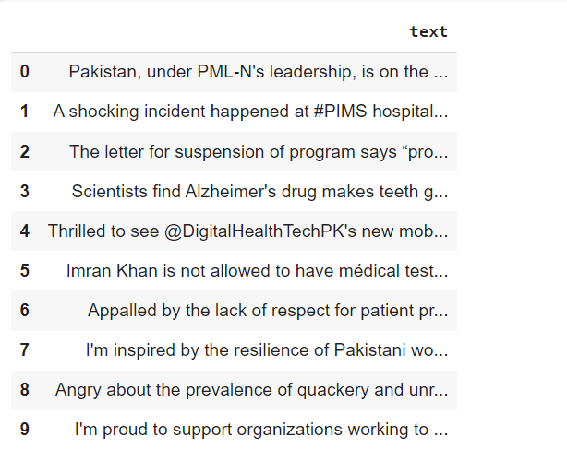
Data Acquisition
Utilized Apify, a web scraping platform, to collect data from Twitter.
Scraped tweets related to healthcare in Pakistan to capture public sentiment and discussions.
Data features include “text” columns containing tweets.
Data spans from 2020 to 2024.
Contains around 4000 records.

Slide 10
Data Preprocessing
Clean and prepare the raw Twitter data (tweets)
Duplicates are removed
Data Cleaning: Remove any irrelevant characters or special symbols
Tokenization: Split the text into individual words or tokens.
Remove hashtags
Remove mentions
Lowercasing: Convert all text to lowercase to ensure consistency
Stopword Removal: Remove common stopwords (e.g., "and", "the") that do not contribute much to sentiment analysis
Lemmatization: Reduce words to their base or root form to normalize variation

Slide 11
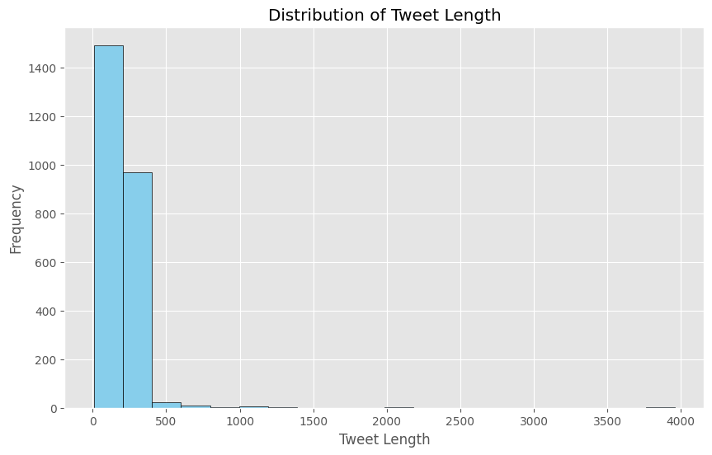
Exploratory Data Analysis (EDA)
Distribution of Tweets Length
Distribution of tweet lengths based on the number of characters in each tweet

Slide 12
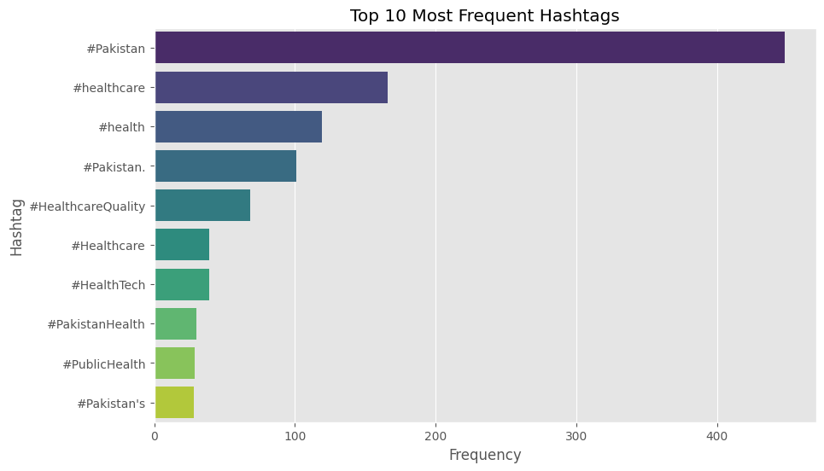
Exploratory Data Analysis (EDA)
Distribution of Hashtags
Top 10 most frequent
hashtags

Slide 13
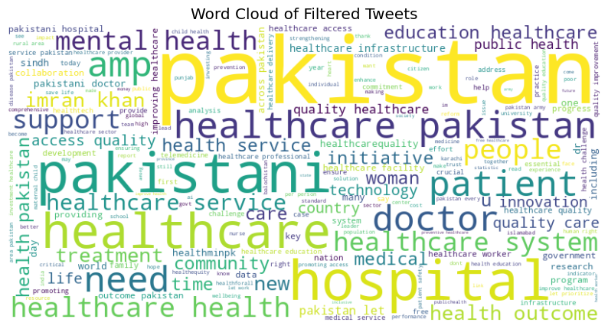
Advanced Data Preprocessing
Word Cloud of Filtered
Tweets

Slide 14
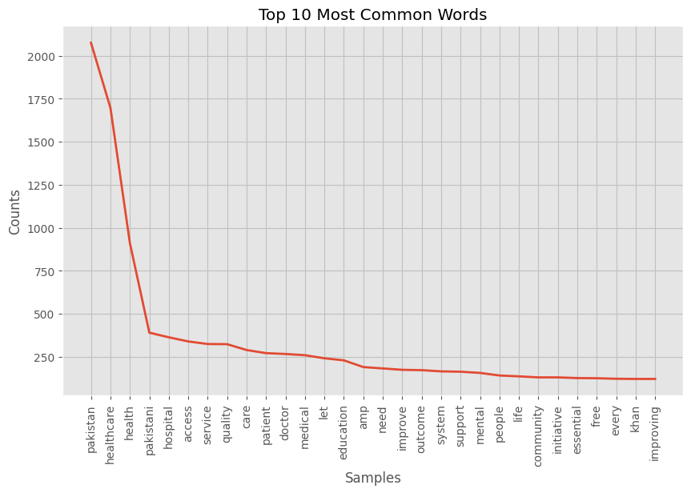
Advanced Data Preprocessing
Word Frequency Analysis with Tokenization

Slide 15
Named Entity Recognition
Uses spaCy's pre-trained NER model for accurate and efficient entity recognition.
Identifies and classifies named entities into predefined categories such as person, organization, location, date, etc.
Enables extraction of important information from text data.
facilitating downstream NLP tasks such as sentiment analysis, topic modeling, and information retrieval.

Slide 16
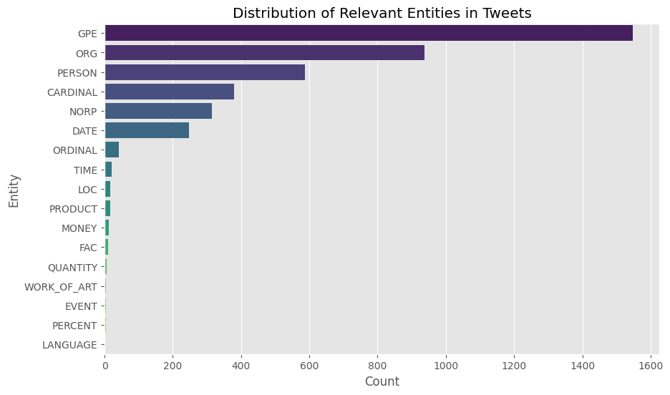
Named Entity Recognition

Slide 17
Topic Modeling Analysis
Uses Latent Dirichlet Allocation (LDA), a statistical technique used to uncover hidden thematic structures within a collection of documents.
Aids in the identification of prevalent topics and patterns.
Topic | Assigned Topic | Top Keywords
0 | Public Perception of Healthcare Providers | pakistani, doctor, hospital, people, new, khan, punjab
1 | Healthcare Quality and Patient Care | patient, quality, care, pakistani, improvement, healthcarequality, hospital, safety, need, health
2 | Health Services and Access | health, access, service, let, mental, care, essential, outcome, improve, wellbeing
3 | Medical Services and Dedication | free, service, medical, health, patient, sindh, dedication, providing, country
4 | Health Education and Innovation | health, education, innovation, technology, let, infrastructure, initiative, research, future, access

Slide 18
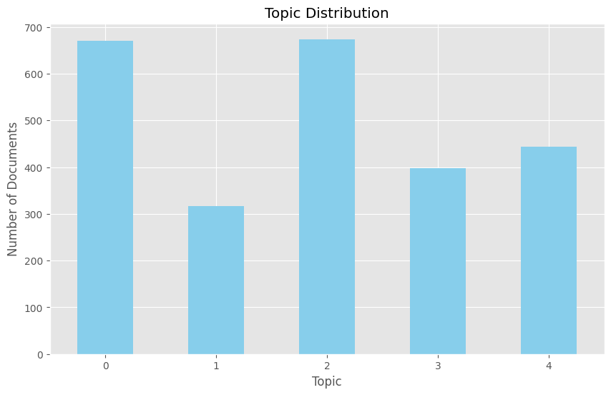
Topic Modeling Analysis

Slide 19
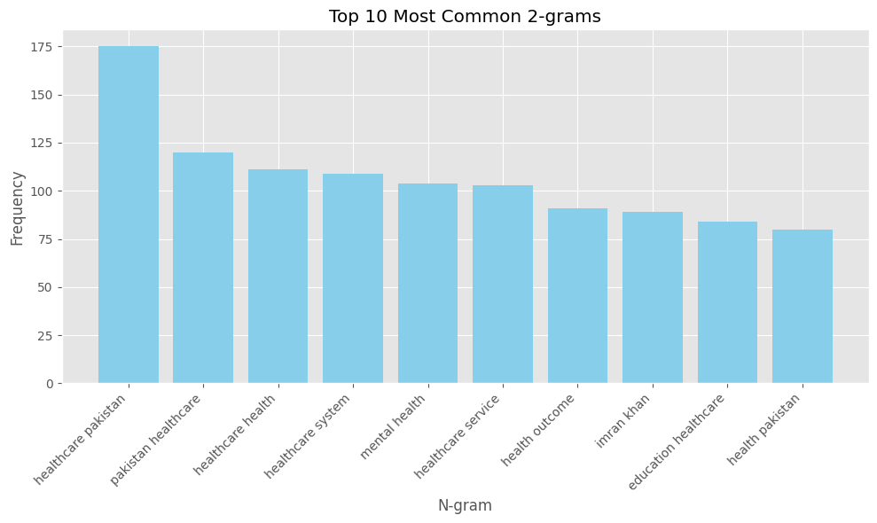
Exploring 2-grams: Visualizing Textual Patterns

Slide 20
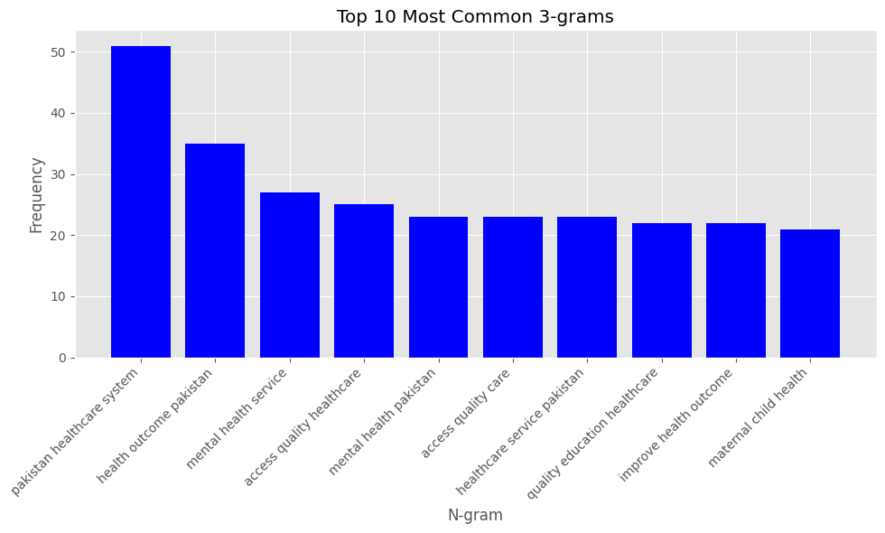
Exploring 3-grams: Visualizing Textual Patterns

Slide 21
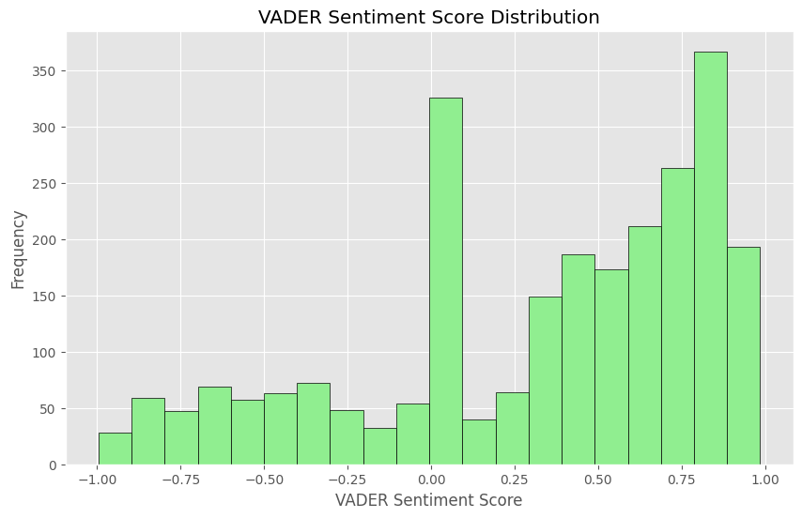
Sentiment Analysis using Vader
Vader Sentiment Analysis:
a rule-based sentiment analysis tool
specifically designed for analyzing
sentiments
expressed in social media texts

Slide 22
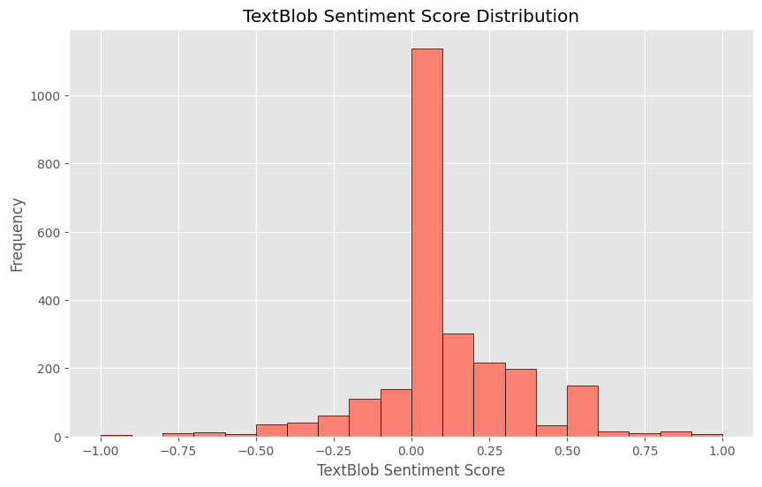
Sentiment Analysis using TextBlob
TextBlob Sentiment Analysis:
a Python library for processing textual data.
a lexicon-based approach to determine
the sentiment polarity of a piece of text.
suitable for quick and straightforward
sentiment analysis tasks.
Polarity: Measures the sentiment polarity
of text on a scale from -1 to 1.

Slide 23
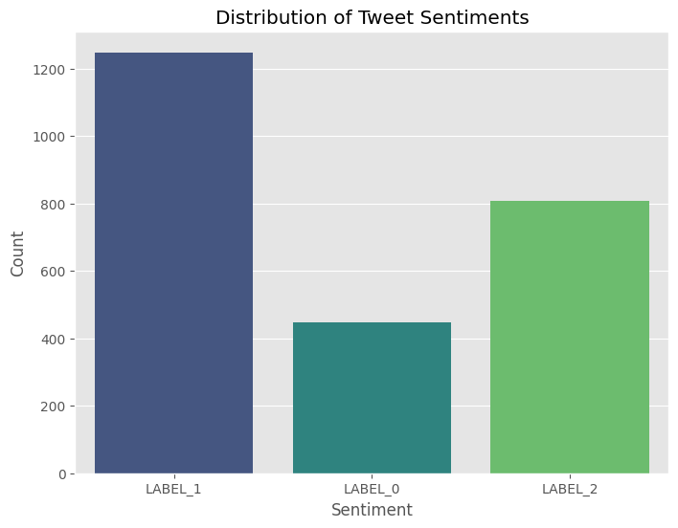
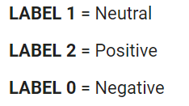
Sentiment analysis RoBERTa model
Roberta is a pre-trained NLP model.
Developed by Facebook AI.
Unlike Vader and TextBlob, Roberta is a
deep learning-based model that offers
advanced capabilities for sentiment analysis.

Slide 24
Sentiment Analysis Results
As shown in the graphs, a significant portion of the tweets were categorized as neutral, followed by positive and negative sentiments.
This suggests that while there is a mix of opinions and discussions on healthcare, a large proportion of the conversation tends to be neutral in sentiment.

Slide 25
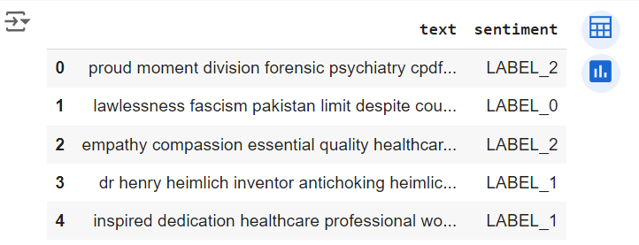
Model Implementation and Evaluation
Features
Text: Content of tweets.
Sentiment: Labels categorized into three classes:
LABEL_0: Negative
LABEL_1: Neutral
LABEL_2: Positive

Slide 26
Model Implementation and Evaluation
Feature Representation: Textual data converted using TF-IDF vectorization before model application.
Data Splitting: Split data into 80/20 ratio for training and testing.
Models Applied
Support Vector Classifier (SVC)
Logistic Regression
Random Forest
Gradient Boosting
Multinomial Naive Bayes
Evaluation Metrics
Accuracy, Precision, Recall, F1-score

Slide 27
Model Evaluation
Model | Accuracy
Gradient Boosting | 79%
Multinomial Naive Bayes | 80%
Logistic Regression | 82%
Support Vector Classifier | 83%
Random Forest | 85%

Slide 28
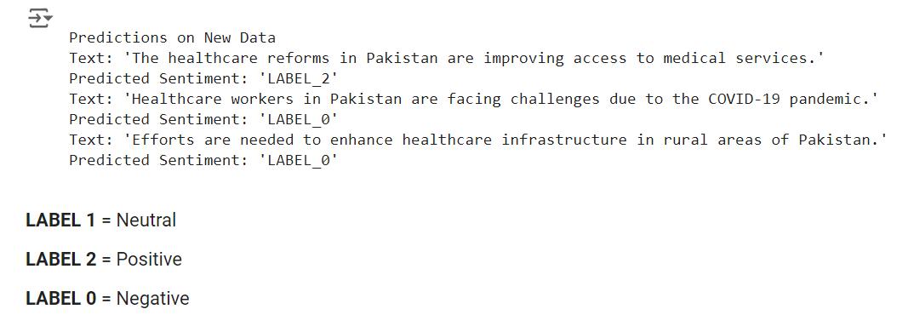
Model Predictions

Slide 29
Results
Results of Sentiment Analysis - The sentiment analysis revealed a predominant distribution among tweets:
Neutral sentiments were the most prevalent.
Positive sentiments were next in frequency.
Negative sentiments constituted a smaller portion of the dataset.
Model Performance:
Random Forest achieved the highest accuracy at 85%.
SVC followed with 83% accuracy.
Logistic Regression and Multinomial Naive Bayes performed similarly, achieving accuracies of 82% and 80%, respectively.
Gradient Boosting showed a slightly lower accuracy at 79%.

Slide 30
Conclusion
Sentiment Analysis:
Neutral tweets dominate.
Positive sentiments show a strong presence.
Negative sentiments are minimal.
Random Forest excels with 85% accuracy.
These findings underscore the value of sentiment analysis and machine learning in understanding public sentiment and opinion dynamics in healthcare discussions.

Slide 31
References
Atif, M. et al. (2022) Perceptions of healthcare professionals and patients on the role of the pharmacist in TB Management in Pakistan: A qualitative study, Frontiers. Available at: https://www.frontiersin.org/journals/pharmacology/articles/10.3389/fphar.2022.965806/full(Accessed: 20 May 2024).
Khan, N. et al. (2020) Pharmacists’ viewpoint towards their professional role in healthcare system: A survey of hospital settings of Pakistan - BMC Health Services Research, SpringerLink. Available at: https://link.springer.com/article/10.1186/s12913-020-05459-0 (Accessed: 20 May 2024).
Muhammad, Q., Eiman, H., Fazal, F., Ibrahim, M. and Gondal, M.F., 2023. Healthcare in Pakistan: navigating challenges and building a brighter future. Cureus, 15(6). Available at: https://assets.cureus.com/uploads/editorial/pdf/161591/20230710-4592-1yspsm3.pdf (Accessed: 20 May 2024).
Chandrasekaran, G. (2020) Vader - simplest model for sentiment analysis, Medium. Available at: https://medium.com/analytics-vidhya/vader-simplest-model-for-sentiment-analysis-d333db856a9e (Accessed: 20 May 2024).
Shah, P. (2020) My absolute go-to for sentiment analysis - textblob., Medium. Available at: https://towardsdatascience.com/my-absolute-go-to-for-sentiment-analysis-textblob-3ac3a11d524 (Accessed: 20 May 2024).
Cardiffnlp/twitter-roberta-base-sentiment · hugging face (no date) cardiffnlp/twitter-roberta-base-sentiment · Hugging Face. Available at: https://huggingface.co/cardiffnlp/twitter-roberta-base-sentiment (Accessed: 20 May 2024).

Slide 32
Thank You!

